Slide 1
A Secure Place
for Secure Information
Password Manager
RSA Encrypted Storage
100% Offline
Personalized Decryption
Gabe Foster & Joel Robinson

Slide 2
High-end
Technologies
Password Manager
A Secure Place
for Secure Information
Python
SQLite databases
PyQt5 GUI software
RSA Encrypted Storage
100% Offline
Personalized Decryption
Gabe Foster & Joel Robinson

Slide 3
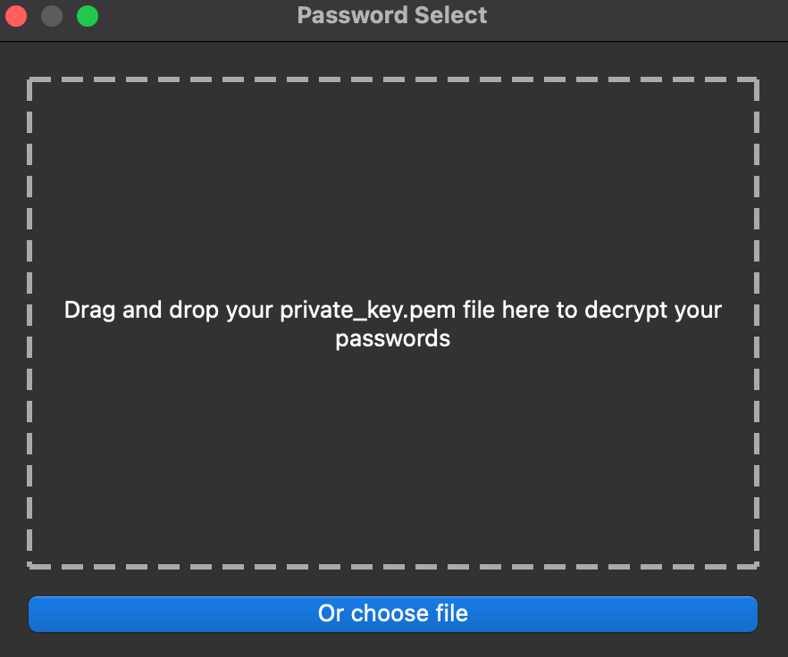
Quick One-Time
Verification Process
A Secure Place
for Secure Information
High-end
Technologies
Python
SQLite databases
PyQt5 GUI software
Find the required private_key.pem file by opening the file explorer
RSA Encrypted Storage
100% Offline
Personalized Decryption

Slide 4


Try Now!
A Secure Place
for Secure Information
Quick One-Time
Verification Process
High-end
Technologies
Mac
Windows
Python
SQLite databases
PyQt5 GUI software
RSA Encrypted Storage
100% Offline
Personalized Decryption
https://bit.ly/MAC_PWMANAGER
https://bit.ly/WIN_PWMANAGER
Find the required private_key.pem file by opening the file explorer

Slide 5
Try Now!
A Secure Place
for Secure Information
Quick One-Time
Verification Process
High-end
Technologies
Mac
Windows
Python
SQLite databases
PyQt5 GUI software
RSA Encrypted Storage
100% Offline
Personalized Decryption
Find the required private_key.pem file by opening the file explorer
https://bit.ly/WIN_PWMANAGER
https://bit.ly/MAC_PWMANAGER

